Slide 1


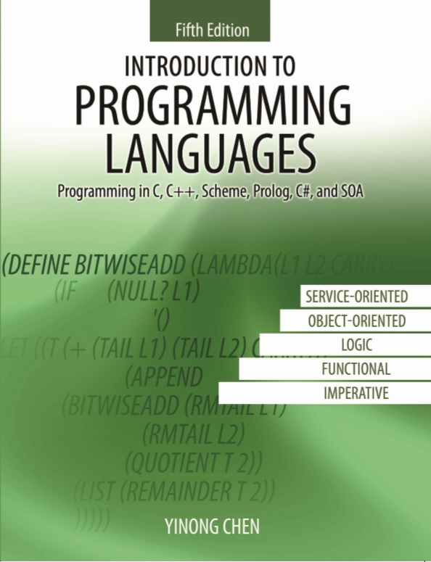
CSE240
Introduction to Programming Languages
Chapter 2
The Imperative Languages C/C++
Lecture 06
C/C++ I/O and Data Declaration
Reading: Textbook Section 2.1
Dr. Yinong Chen

Slide 2
Chapter 2 Outline
Imperative language C/C++
Getting started with C/C++ programming: I/O
Data declaration and scope rules
Basic data types
Basic computer organization
Arrays and strings
Pointers, Arrays, and Strings
Pointer and Constants, Enumeration, Struct of Arrays
Padding, File System, and Buffer Flushing
Linked Lists
Parameter Passing
Recursion
Large examples of recursion and structures
Modules and Packages
Summary

Slide 3
Imperative Paradigm
In Chapter 1, Imperative paradigm is defined:
fully specified and fully controlled manipulation of named data in a stepwise fashion.
Developed as abstractions of von Neumann machine (stored program concept).
Programs are algorithmic in nature: do this, then that, then repeat this ten times --- focuses on how rather than what.
Why popular
Performance
Culture

Slide 4
Getting Started with C/C++
The parts (components) of a C/C++ program are called functions. There are two kinds of functions:
Built-in functions are pre-written and exist in libraries, i.e.: input and output functions (printf, scanf , cin, cout), and mathematical functions (sin, cos, sqrt).
User defined functions are written by the programmers.
Functions may also exist outside any class, and variables may exist outside any class or functions. These functions and variables are called global. This is different from Java.
Each C/C++ program must contain exactly one main( ) function.

Slide 5
The main( ) Function in C/C++
Like Java, main( ) is the entry point for program execution.
Unlike Java, main( ) in C/C++ is not contained in any class.
The shortest and simplest program is thus:
main () { }
int main() {...; return …}
double main (int argc, char *argv [ ]) {...; return …}
The main( ) function taking arguments allows the program to take command line inputs, which are used to specify options, e.g., the name of the data file.

Slide 6
C-Style Input/Output
Your first program:
/* This is my first program. In this program, I enter a number from the keyboard, process the number and then print the result. */
#include <stdio.h> // C I/O library
main () {
int i, n = 5;
printf(“Hi, please enter an integer: ”);
scanf(“%d”, &i); // input function
if (i > n)
n = n + i;
else n = n - i;
printf(“i = %d, n = %d\n”, i, n); //output function
}

Slide 7
Formatted C-Style Input/Output
Input: scanf (control sequence, &variable1, ... &variablen);
Output: printf (control sequence, expressions);
&variable: address of the variable (call by address).
The “expressions” is the list of expressions whose values are to be printed out. Each expression is separated by a comma.
The control sequence includes the constant string to be printed, e.g., "i = ", and control symbols to be used to convert the input/output from their numeric values that are stored in the computer to their character format displayed:
%d for integer
%f for floating point, or %5.2f (at least 5 wide and a precision of 2)
%c for character
%s for string of characters
%x for hexadecimal number

Slide 8
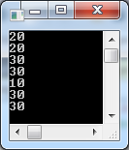
C Style I/O: scanf and printf Examples
include <stdio.h> //
void foo(int *n) {
printf("%d\n", *n);
*n = 30;
printf("%d\n", *n);
}
void main() {
int i = 0;
scanf("%d", &i); // enter 20
foo(&i); // the ampersand is used for address of i
printf("%d\n", i);
i = 10;
foo(&i);
printf("%d\n", i);
}
C programs are full of pointers, from I/O to everywhere.

Slide 9
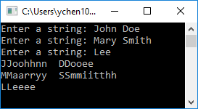
C Style I/O: fgets, reading a line with space
char *fgets(char *line, int size, FILE *pf);
#include <stdio.h>
#define count 3
#define stringSize 32
void main() {
char names[count][stringSize]; // 2D array, hold strings of up to 31 chars
char name[stringSize]; int i, j; // 1D array
for (i = 0; i < count; i++) {
printf("Enter a string: "); // prompt for a string
fgets(name, sizeof(name), stdin); // read input, and store in name
name[strlen(name) - 1] = '\0'; // convert '\n' to '\0' (null terminator)
strcpy(names[i], name); // copy name to one element in 2D strings array
}
for (i = 0; i < count; i++) {
for (j = 0; j < strlen(names[i]); j++)
printf("%c%c", names[i][j], names[i][j]);
printf("\n");
}
i = getchar(); // keep console open
}
names
J
J
o
o
h
h
n
n
D
D
o
o
e
e
\0
M
M
a
a
r
r
y
y
S
S
m
m
i
t
t
h
h
\0
L
L
e
e
e
e
\0
You may need to use:
i = getchar(); // remove '\n'
i = getchar(); // keep open

Slide 10
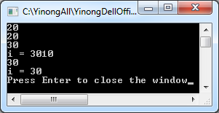
Formatted C++ I/O and C Style I/O
using namespace std; // C++ lib for C++ I/O
#include <iostream> // C++ lib allows you to use C-style I/O
void foo(int *n) {
printf("%d\n", *n);
*n = 30;
printf("%d\n", *n); return; }
void main() {
int i = 0;
cin >> i; // enter an integer, e.g., 20
foo(&i); // the ampersand is used for address of i
cout << "i = " << i; // C++ I/O
i = 10;
foo(&i);
cout << "i = " << i << endl; // C++ I/O
cout << "Press Enter to close the window";
}

Slide 11
Unformatted: Input a String with Space Characters
To enter a string with space, C uses fgets() and C++ uses cin.getline() function.
using namespace std; //also see text page 41
void main() {
char line[25];
cout << "Please enter a line ended by '@'" << endl;
cin.getline(line, 25, '@'); // either 25 chars
// or ‘@’ is entered at the end
cout << line << endl;
}

Slide 12
C/C++ Input / Output Summary
Unformatted: Read characters and string
getchar(), putchar()
fgets
cin.get(), cin.getline()
Formatted: Read also int, float, etc.
scanf(), printf(), based on control character
cin, cout, based on the type of the variable
Unformatted input will read the '\n' left in the input buffer from a previous operation and it needs to be flushed by a fflush() or a getchar(), or a cin.ignore() to remove the '\n'.
We will discuss the file and I/O in more detail in text section 2.6.

Slide 13
What is a Program?
Program
Algorithm
Data
Data
Process (steps) of data manipulation
Objects of the manipulation
Emphasis:
Imperative
Procedural Paradigms
Emphasis:
Object-Oriented Paradigm

Slide 14
Data
In the imperative paradigm data are represented by states — collections of variables and their values.
Key concepts of data:
type: what values and operations are allowed
location: where data are stored in memory
address: an integer associated to a location
reference/pointer: a name associate with the variable that holds an address of a location
variable name: a name associated with a location
value: what stored in a memory location
scope (lifetime) and visibility

Slide 15
Data Declaration
At the machine level, the value stored in any memory location is a sequence of bits (bit pattern): 00101011… .
A variable declaration binds a name to a location in memory, and describes the attributes of the value in the location:
Type (how you want to interpret the bit pattern)
Scope (existence and visibility)
Qualifier (modifiability, e.g., constant)
Typically the compiler allocates memory for the variable and binds the name to that location when a variable is declared.
Declaration in C/C++:
typename variables,
separated by comma, e.g.,
int i = 0, j, k;
doube x = 3.0, y, z = 2.5;
Name Address Initial Value
i 8000 0
j 8004
k 8008
x 8400 3.0
y 8408
z 8416 2.5

Slide 16
Scope of Declaration
Scope Rule: The scope of a variable starts from its declaration point and extends to the end of the current block in a pair of braces.
Declaration-before-use: Variables and functions must be declared before they are used.
{ int height = 6; int width = 6;
int area = height * width;
. . .
} // block ends
Problem of declaration-before-use for mutually recursive function calls:
function F calls G, and G calls F.
Forward declaration (prototype): Declare a function in two steps: A forward declaration and a genuine declaration.
Can you swap the order?

Slide 17
Scope Rule: Forward Declaration
void bar(void); // forward declaration to satisfy scope rule
int foo(void); // forward declare all functions
// it is necessary in this case, & desired as table of contents
int foo(void) { // genuine declaration
. . .
bar(); // call function bar()
. . .
}
void bar(void) { // genuine declaration
. . .
k = foo() // call function foo()
. . .
}

